Slide 1

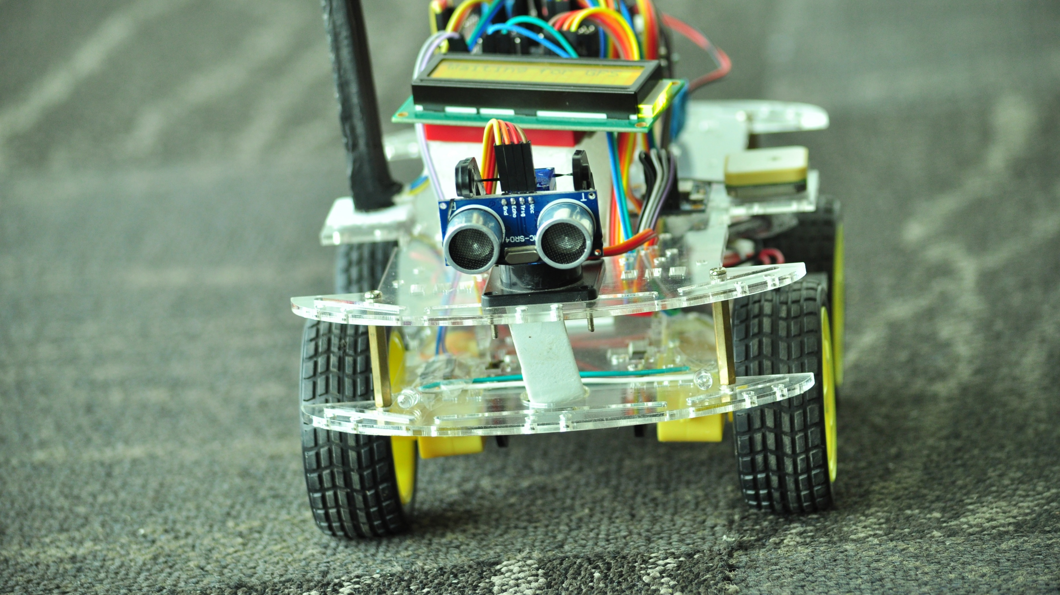
aucovei
(autonomous connected car)

Slide 2
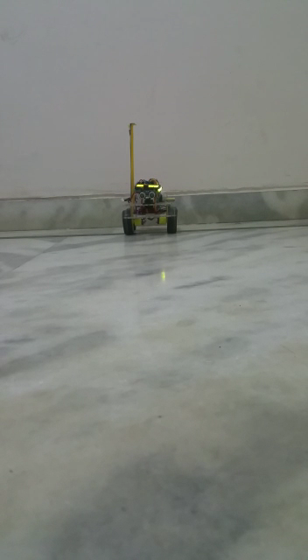

Introducing aucovei

Slide 3
What’s “IOT”
Notes:
The Internet of Things (IoT) is the network of physical objects or "things" embedded with electronics, software, sensors, and network connectivity, which enables these objects to collect and exchange data.^{[1]} The Internet of Things allows objects to be sensed and controlled remotely across existing network infrastructure,^{[2]} creating opportunities for more direct integration between the physical world and computer-based systems, and resulting in improved efficiency, accuracy and economic benefit.^{[3][4][5][6][7][8]} Each thing is uniquely identifiable through its embedded computing system but is able to interoperate within the existing Internet infrastructure. Experts estimate that the IoT will consist of almost 50 billion objects by 2020.^{[9]}

Slide 4

Welcome to Internet of Things
Welcome to Internet of Things
$1.7 trillion
Market for IoT by 2020 IDC
25 billion Connected “things” by 2020 Gartner

Slide 5
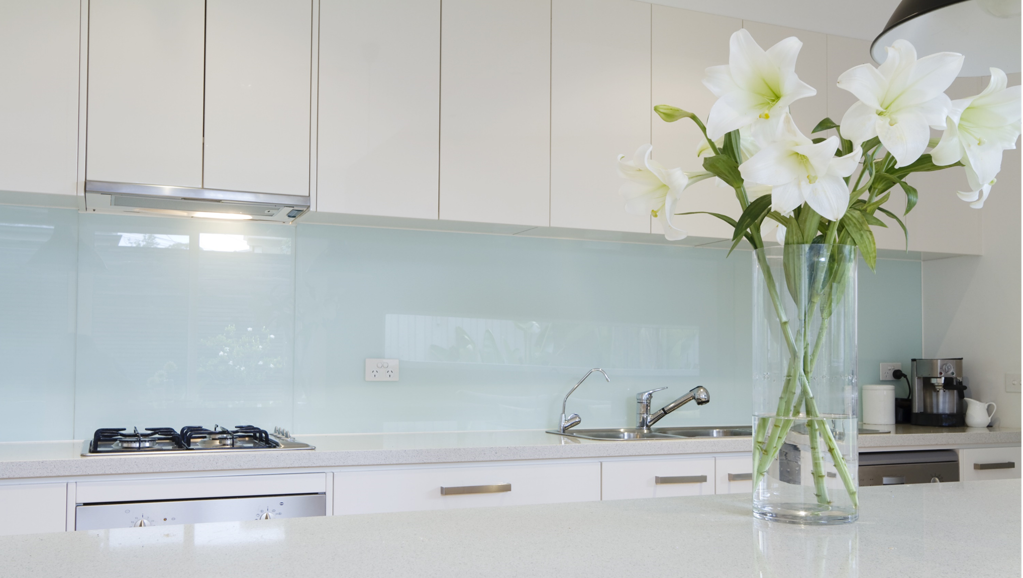
SODA

Slide 6

SODA

Slide 7


SODA

Slide 8
SODA

Slide 9
SODA

Slide 10
You’re drinking
soda
SODA

Slide 11
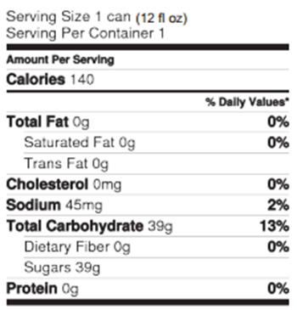
It has140
Calories
SODA

Slide 12





Slide 13

Smarter Socks

Slide 14


Slide 15
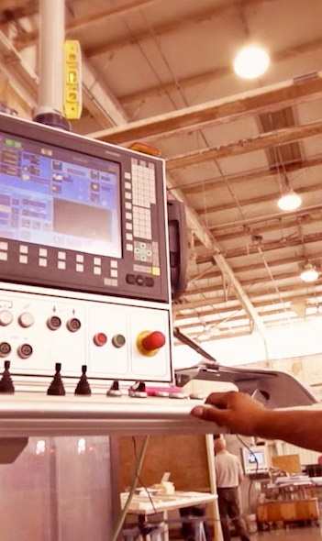
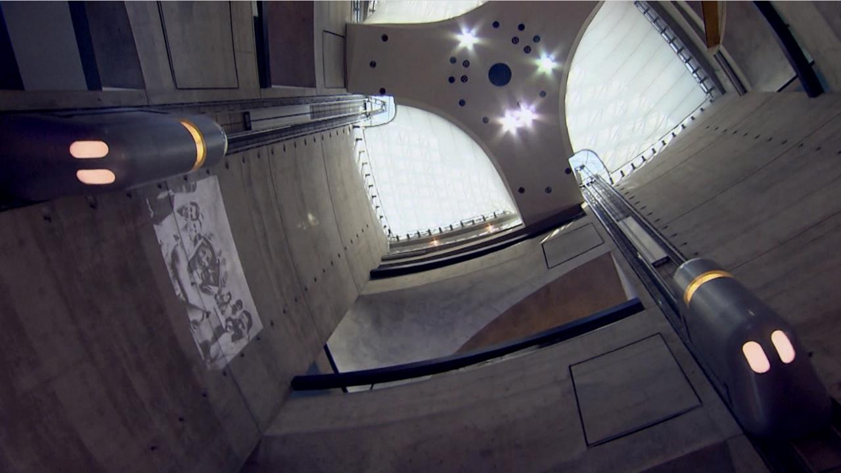

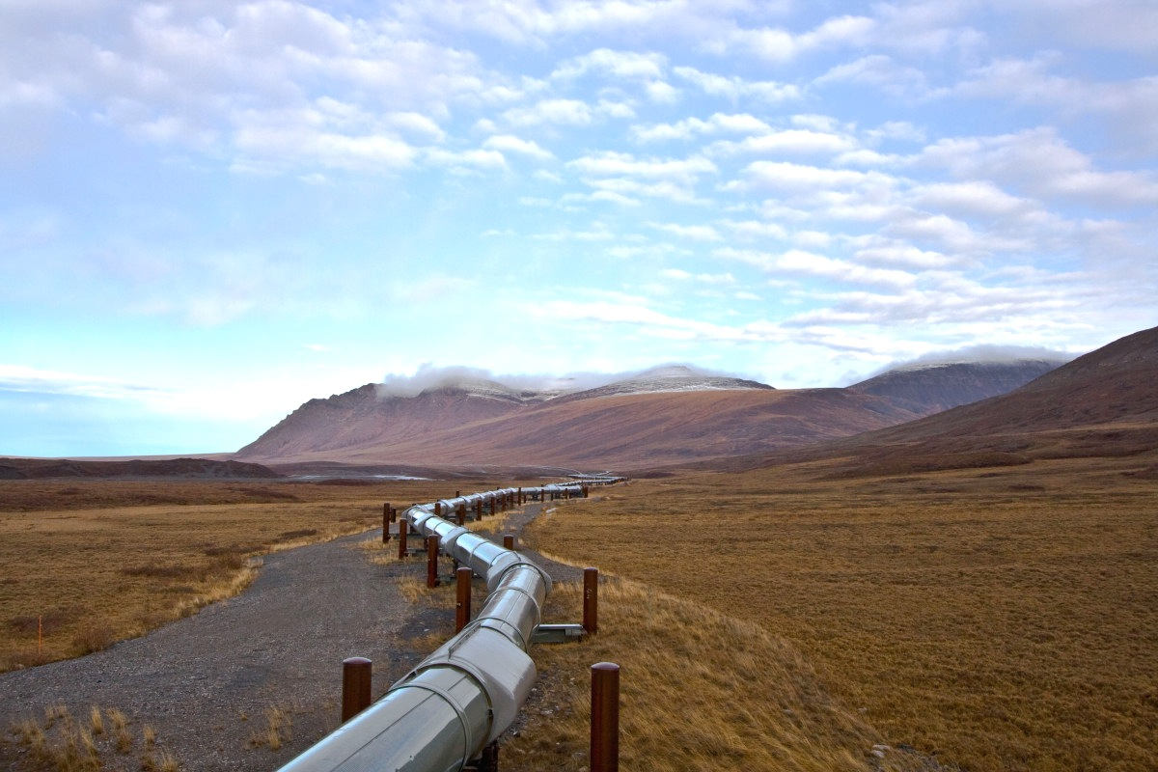

Organizations are benefiting from IoT today
Lido Stone Works
Notes:
Talking Points
We want to emphasize that IoT is real today with customers. Customers are implementing IoT Solutions today.
Lido Stone Works
Lido Stone Works manufactures high-end stone installations for leading architectural firms worldwide. To improve efficiency, profitability and reliability, Lido Stone Works wanted an automated production environment. Lido implemented a solution that connected their machines on the factory floor to Azure which allowed the machines to be monitored remotely. Lido boosted revenue by 70 percent and productivity by 30 percent, while Breton cut maintenance travel costs by approximately €400,000 (US$524,000) by assisting customers remotely
ThyssenKrupp Elevators
Using IoT technology, ThyssenKrupp focused on one thing: reliability. They connected all their elevators to the cloud to gather data from sensors and systems in order to take advantage of valuable business intelligence. TK leveraged our back-end analytics and notification system to alert technicians of elevators that needed maintenance before they cause problems, significantly reducing downtime while increasing customer satisfaction.
Autolib
As another example, intelligent car-sharing service Autolib’ used Microsoft technologies for IoT to connect its kiosks, charging stations, and in-car systems to a back-end system, reducing CO2 emissions by an estimated 75 metric tons by 2023, cutting drivers’ transportation costs by 90 percent.
Rockwell Automation
Rockwell Automation, the world’s largest industrial automation and information firm, improved its offerings by using IoT to collect, integrate, and organize sensor data from remote industrial equipment across global supply chains to support real-time insight and predictive analytics. Rockwell is meeting customer needs even more effectively by leveraging insights from connected products, reducing downtime costs by as much as $300,000 per day.

Slide 16


Slide 17
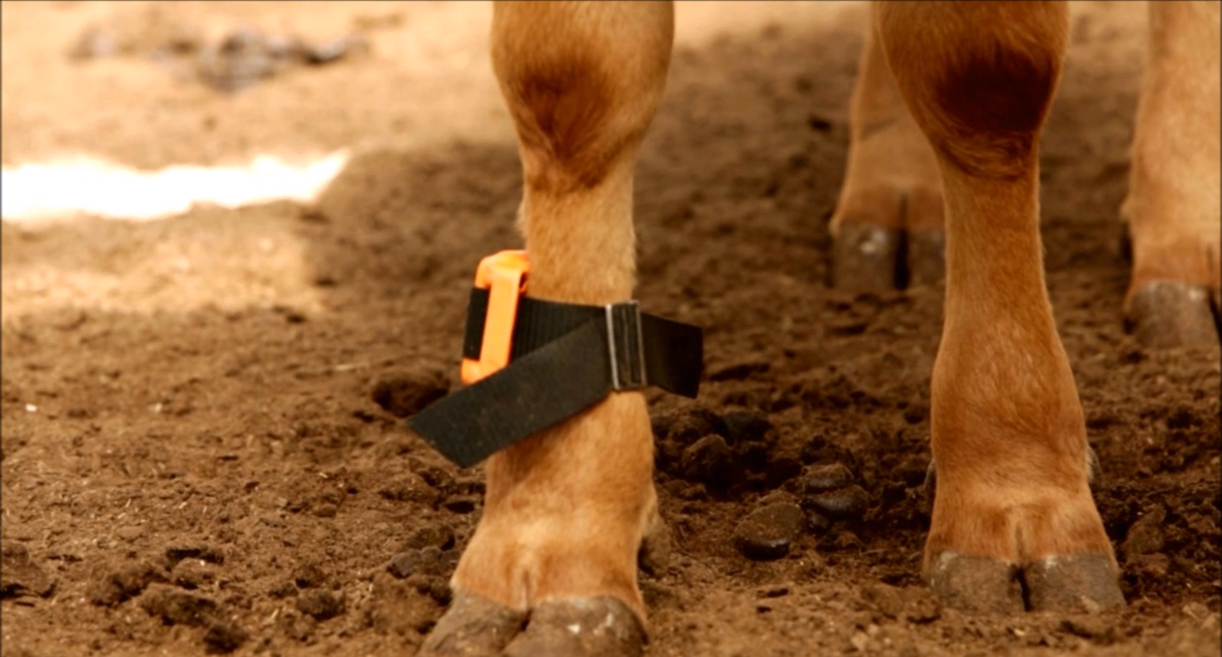
Fujitsu Connected Cow Solution
Detect health issues early and prevent loss
Improve cattle production by accurate detection of estrus
More info here… http://news.microsoft.com/features/connected-cows-help-farms-keep-up-with-the-herd/

Slide 18

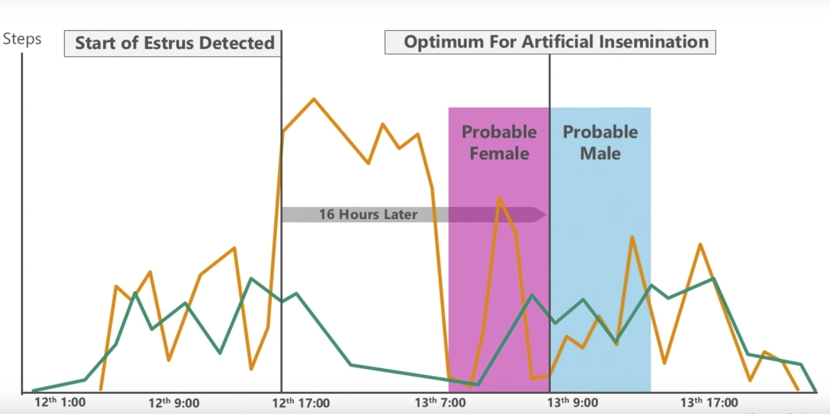
GYUHO “Cow Step” Service

Slide 19
NETWORK
ANALYTICS
GYUHO “Cow Step” Service
COWSHED
BASE STATION
INTERNET
CLOUD CENTER
DIPOLE ANTENNA
RECEIVER
HOUSE/OFFICE
3G CARD
ROUTER
PEDOMETER
SENSOR
COMMUNICATION

Slide 20
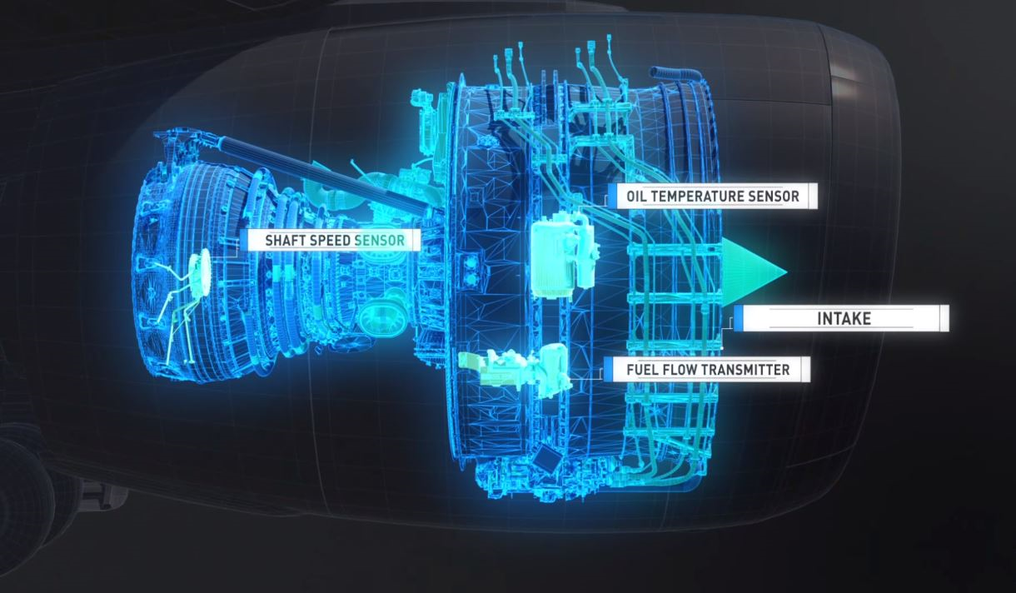
S
Digital Twin
It’s a virtual representation of elements and dynamics of an internet of things device as it goes through it’s lifecycle.
It’s a virtual representation of both elements and the dynamics of how an Internet of things device operates and lives throughout its life cycle.
Notes:
Digital twins integrate artificial intelligence, machine learning and software analytics with spatial network graphs^{[3]} to create living digital simulation models that update and change as their physical counterparts change. A digital twin continuously learns and updates itself from multiple sources to represent its near real-time status, working condition or position. This learning system, learns from itself, using sensor data that conveys various aspects of its operating condition; from human experts, such as engineers with deep and relevant industry domain knowledge; from other similar machines; from other similar fleets of machines; and from the larger systems and environment in which it may be a part of. A digital twin also integrates historical data from past machine usage to factor into its digital model.

Slide 21
Waves of Innovation
Cloud
Globally available, unlimited compute resources
IoT
Harnessing signals from sensors and devices, managed centrally by the cloud
Edge
Intelligence offloaded from the cloud to IoT devices
AI
Breakthrough intelligence capabilities, in the cloud and on the edge

Slide 22
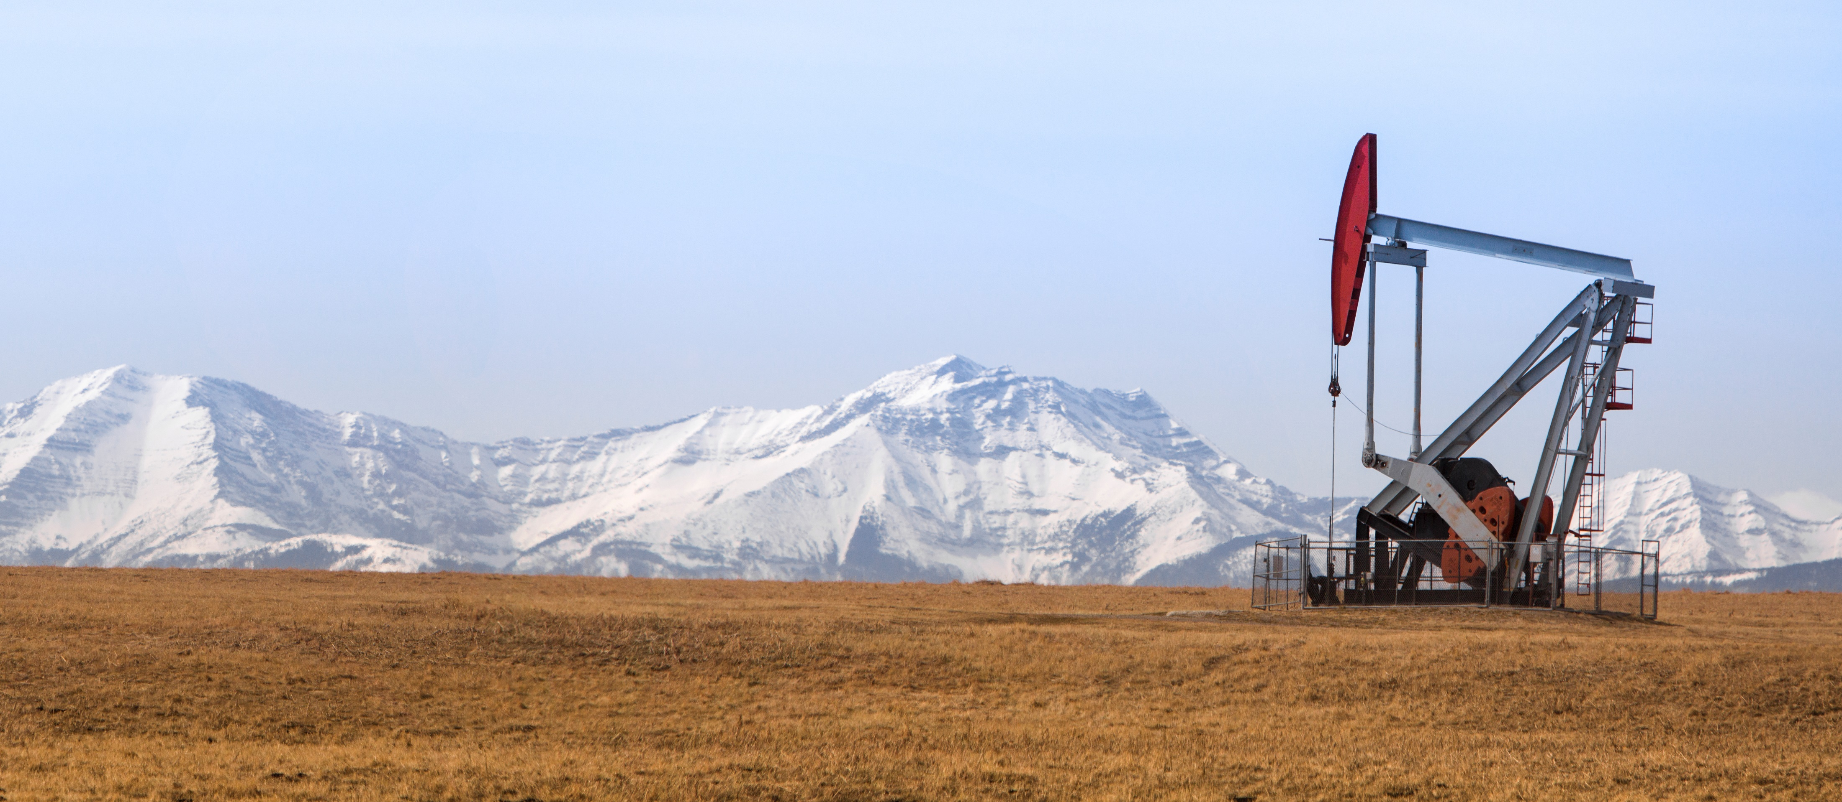
IoT Edge
Notes:
Bringing the cloud analytics and custom business logic to devices so that your organization can focus on business insights instead of data management

Slide 23
IoT in the Cloud and on the Edge
IoT in the Cloud
Remote monitoring and management
Merging remote data from multiple IoT devices
Infinite compute and storage to train machine learning and other advanced AI tools
IoT on the Edge
Low latency tight control loops require near real-time response
Protocol translation & data normalization
Privacy of data and protection of IP
Symmetry

Slide 24
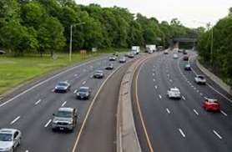
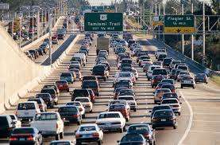

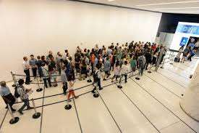
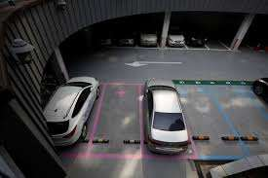
Few Use Cases…
Road traffic detection
Wait line estimation
Parking spot finder

Slide 25
What is a Connected Car?
A connected car is a car that is equipped with internet access and has the ability to send vehicle telemetry and receive commands to/from a cloud infrastructure in order to provide additional benefits to the drivers related to comfort, safety alerts etc...
Notes:
Fact: First connected car was built in 1996 by GM motors
A few use cases:
Vehicle Information
Trips
Proactive Alerts
Receive various alerts e.g. engine oil low, service reminder or tyre pressure low
Commands
Remote Car or AC Start\Stop from mobile app
Driver Safety
Intruder alert or collision alert to family
Valet Assist

Slide 26


Minimalistic Architecture
ECU
ECU
TCU
ECU
CAN BUS
ECU
Notes:
ECU: Electronics control Unit e.g. Engine Control Unit, PowerTrain CU, powerbrakes head unit etc..
CAN: Controller Area Network
TCU: Telematic Control Unit: Provides the cloud connectivity and data exchange. It connects to the CAN and listens to data or events which it processes before sending to cloud.
OBD: On-board diagnostics: Opens a channel to the CAN bus through with an OBD device can read signals from various ECU’s to detect failures
On-Board Diagnostics (OBD), as the name suggests, refers to the in-vehicle system that detects and reports the status of vehicle health. With the help of an OBD port (fitted in a vehicle) and OBD connector, the repair technician/after-sales service provider gets access to critical vehicle parameters like vehicle speed, engine data, emission data and more in the form of Diagnostic Trouble Codes (DTC)

Slide 27



Slide 28
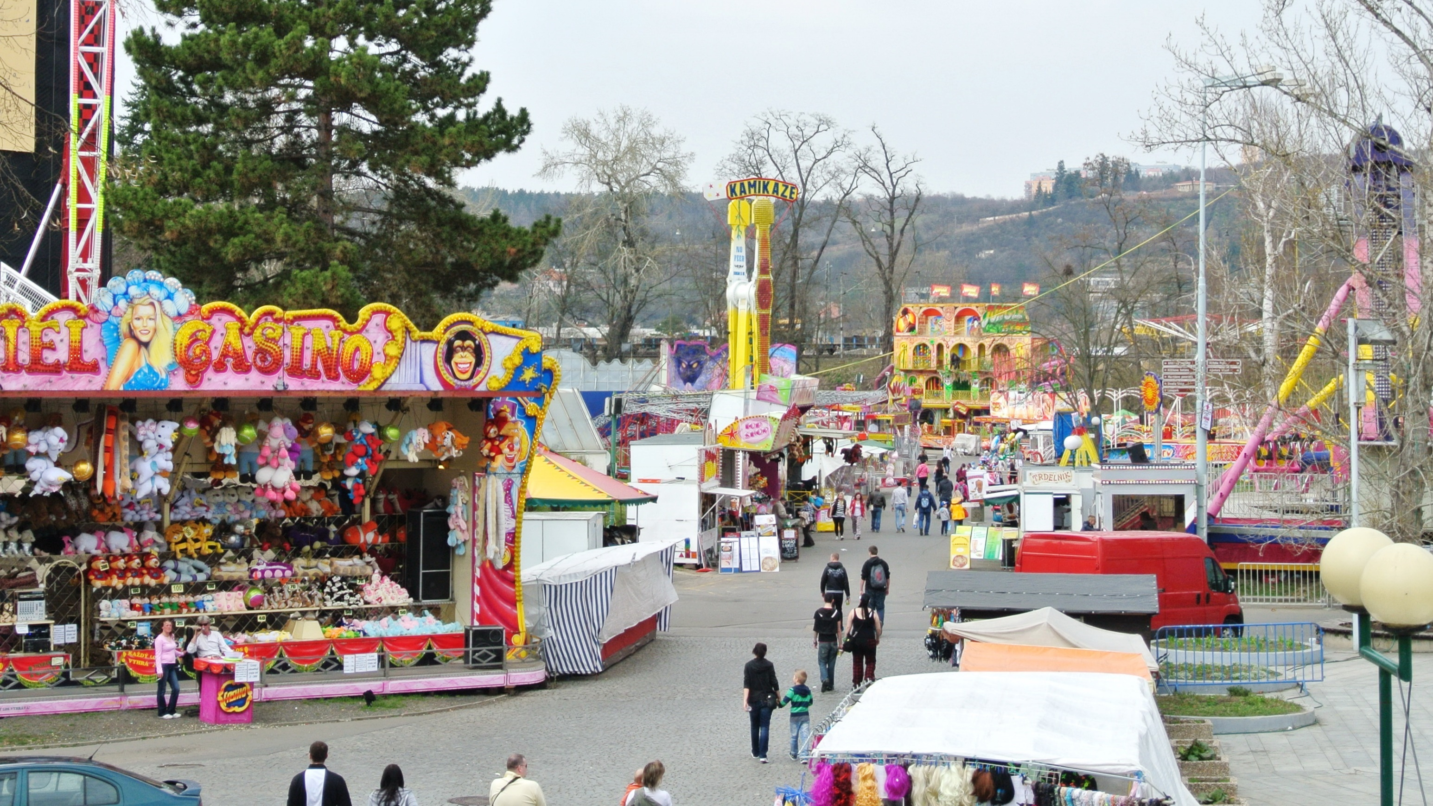
Scenarios
1
Smart Logistics
2
Amusement Parks
3
Cargo Movement

Slide 29



The Scenario: SMART LOGISTICS
Cargo movement
and monitoring
Fleet management and vehicle telematics
Predictive maintenance and safety

Slide 30
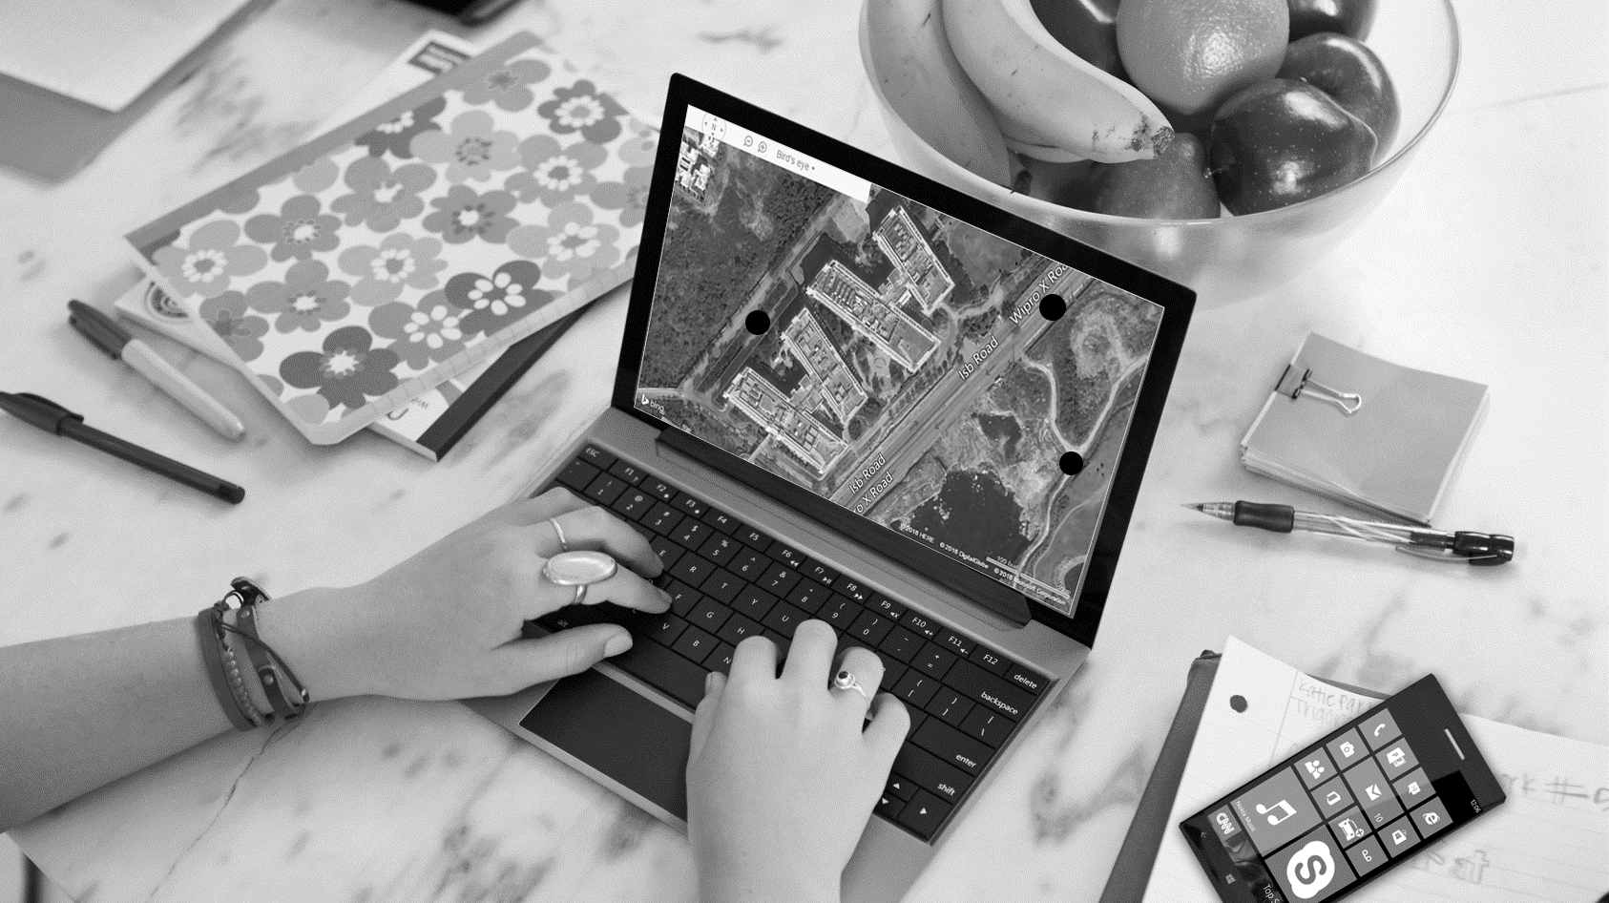
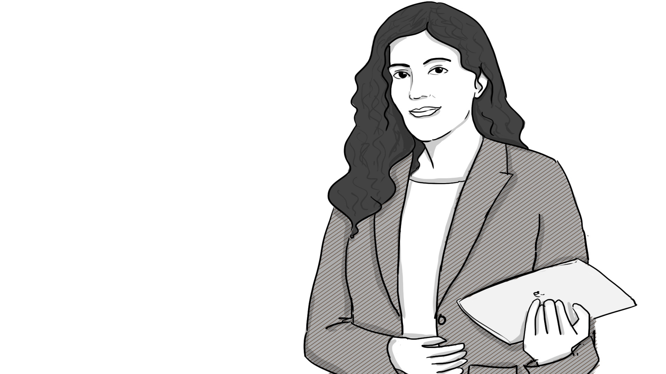
Sharron Warren
Store Manager
Looking after aucovei vehicles health
Identifying the right vehicle for fastest delivery
Set delivery points

Slide 31
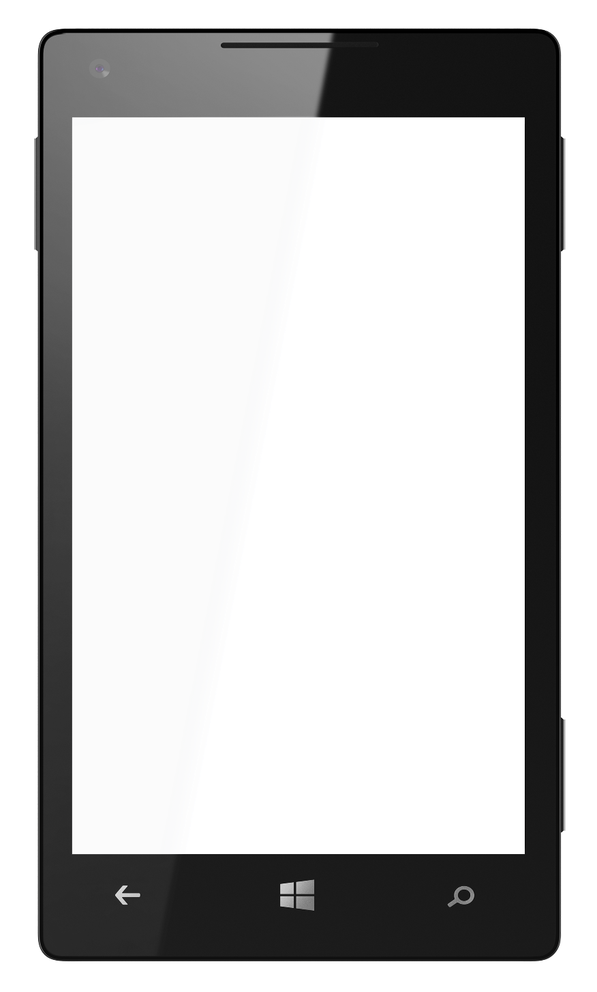
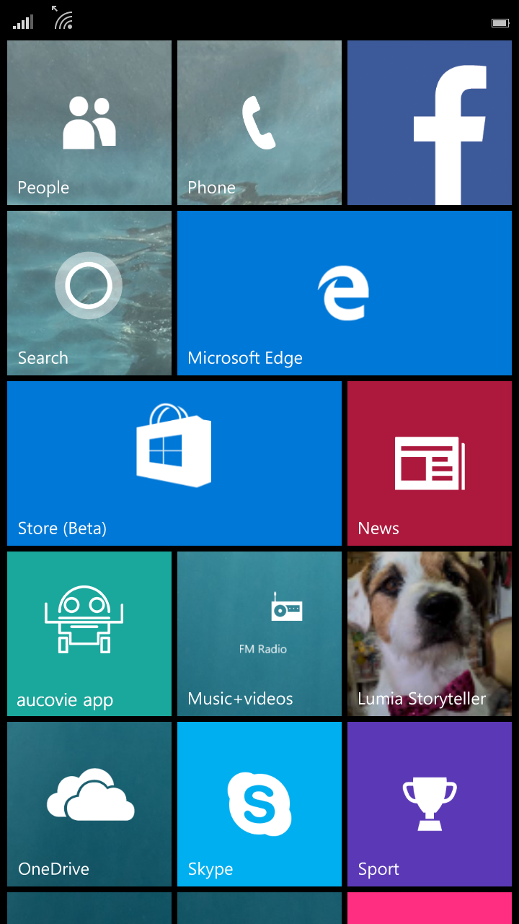


Next Delivery
2:30 PM – Schedule aucovei
<
15 minutes
Snooze
Dismiss
Sharron Warren
Store Manager
Sharron gets a reminder of upcoming delivery schedule on her mobile device. She opens the aucovei UWP App to view the list of available aucoveis.

Slide 32



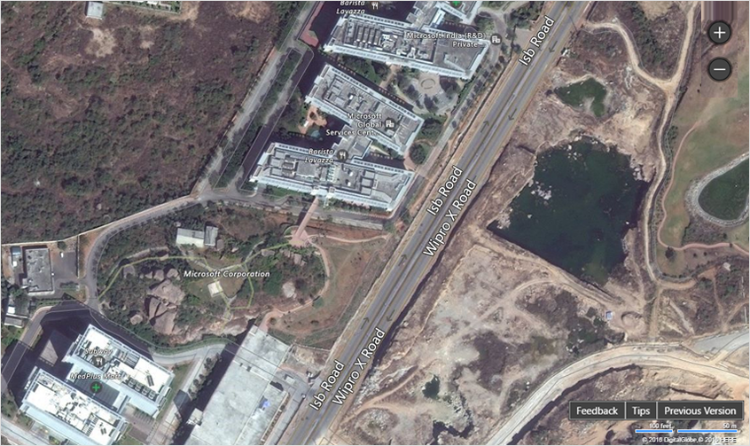
aucovei management
All aucoveis in the selected area
Engaged (2) Available (4) On hold (1)
Map View
List View
Deliveries
Deliver ID | Address | Status
IOVR 32 | A, North Block | Delivered
IOVY 45 | 6th Avenue Link | On the Way
IOVT 23 | Crossroads, 78 | Not started
JUKL 12 | Model Town Gate 2 | Not Started
JUKV 45 | Microsoft Gate 5 | Not Started
Sharron Warren
Store Manager
She looks at the list of available aucovei vehicles, clicks on them and checks the vehicle health (battery, tyre pressure etc.) And identifies the vehicle for the next delivery.

Slide 33



aucovei management
Home > aucovei health dashboard
Device Name/Tag
Status
AUC 165
AVAILABLE
Assign
Coordinates
17°26′30″N 78°22′58″E
Health
Battery
45% remaining
6.5 hours
Tyre
Pressures - Good
Alignment - Good
GPS
Signals working fine
Sharron Warren
Store Manager
She looks at the list of available aucovei vehicles, clicks on them and checks the vehicle health (battery, tyre pressure etc.) And identifies the vehicle for the next delivery.

Slide 34
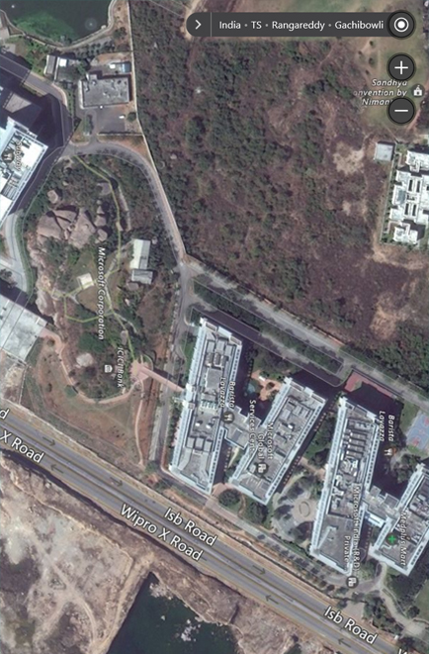
aucovei management
Home > aucovei health dashboard
B
AUC 165
A
Assign
Sharron Warren
Store Manager
Using the map she clicks and taps on the starting point (A) and destination point (B) to assign the delivery to the selected aucovei.

Slide 35
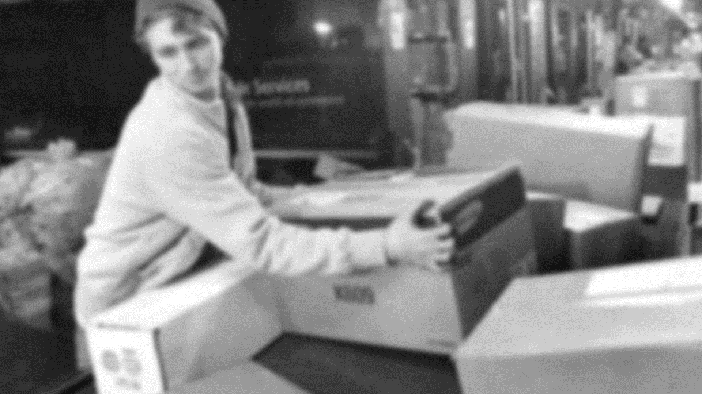

Brain Wickham
Loading supervisor at starting point A
Loading the aucovei vehicle as per the requirement received on the mobile
Dispatch the aucovei.

Slide 36


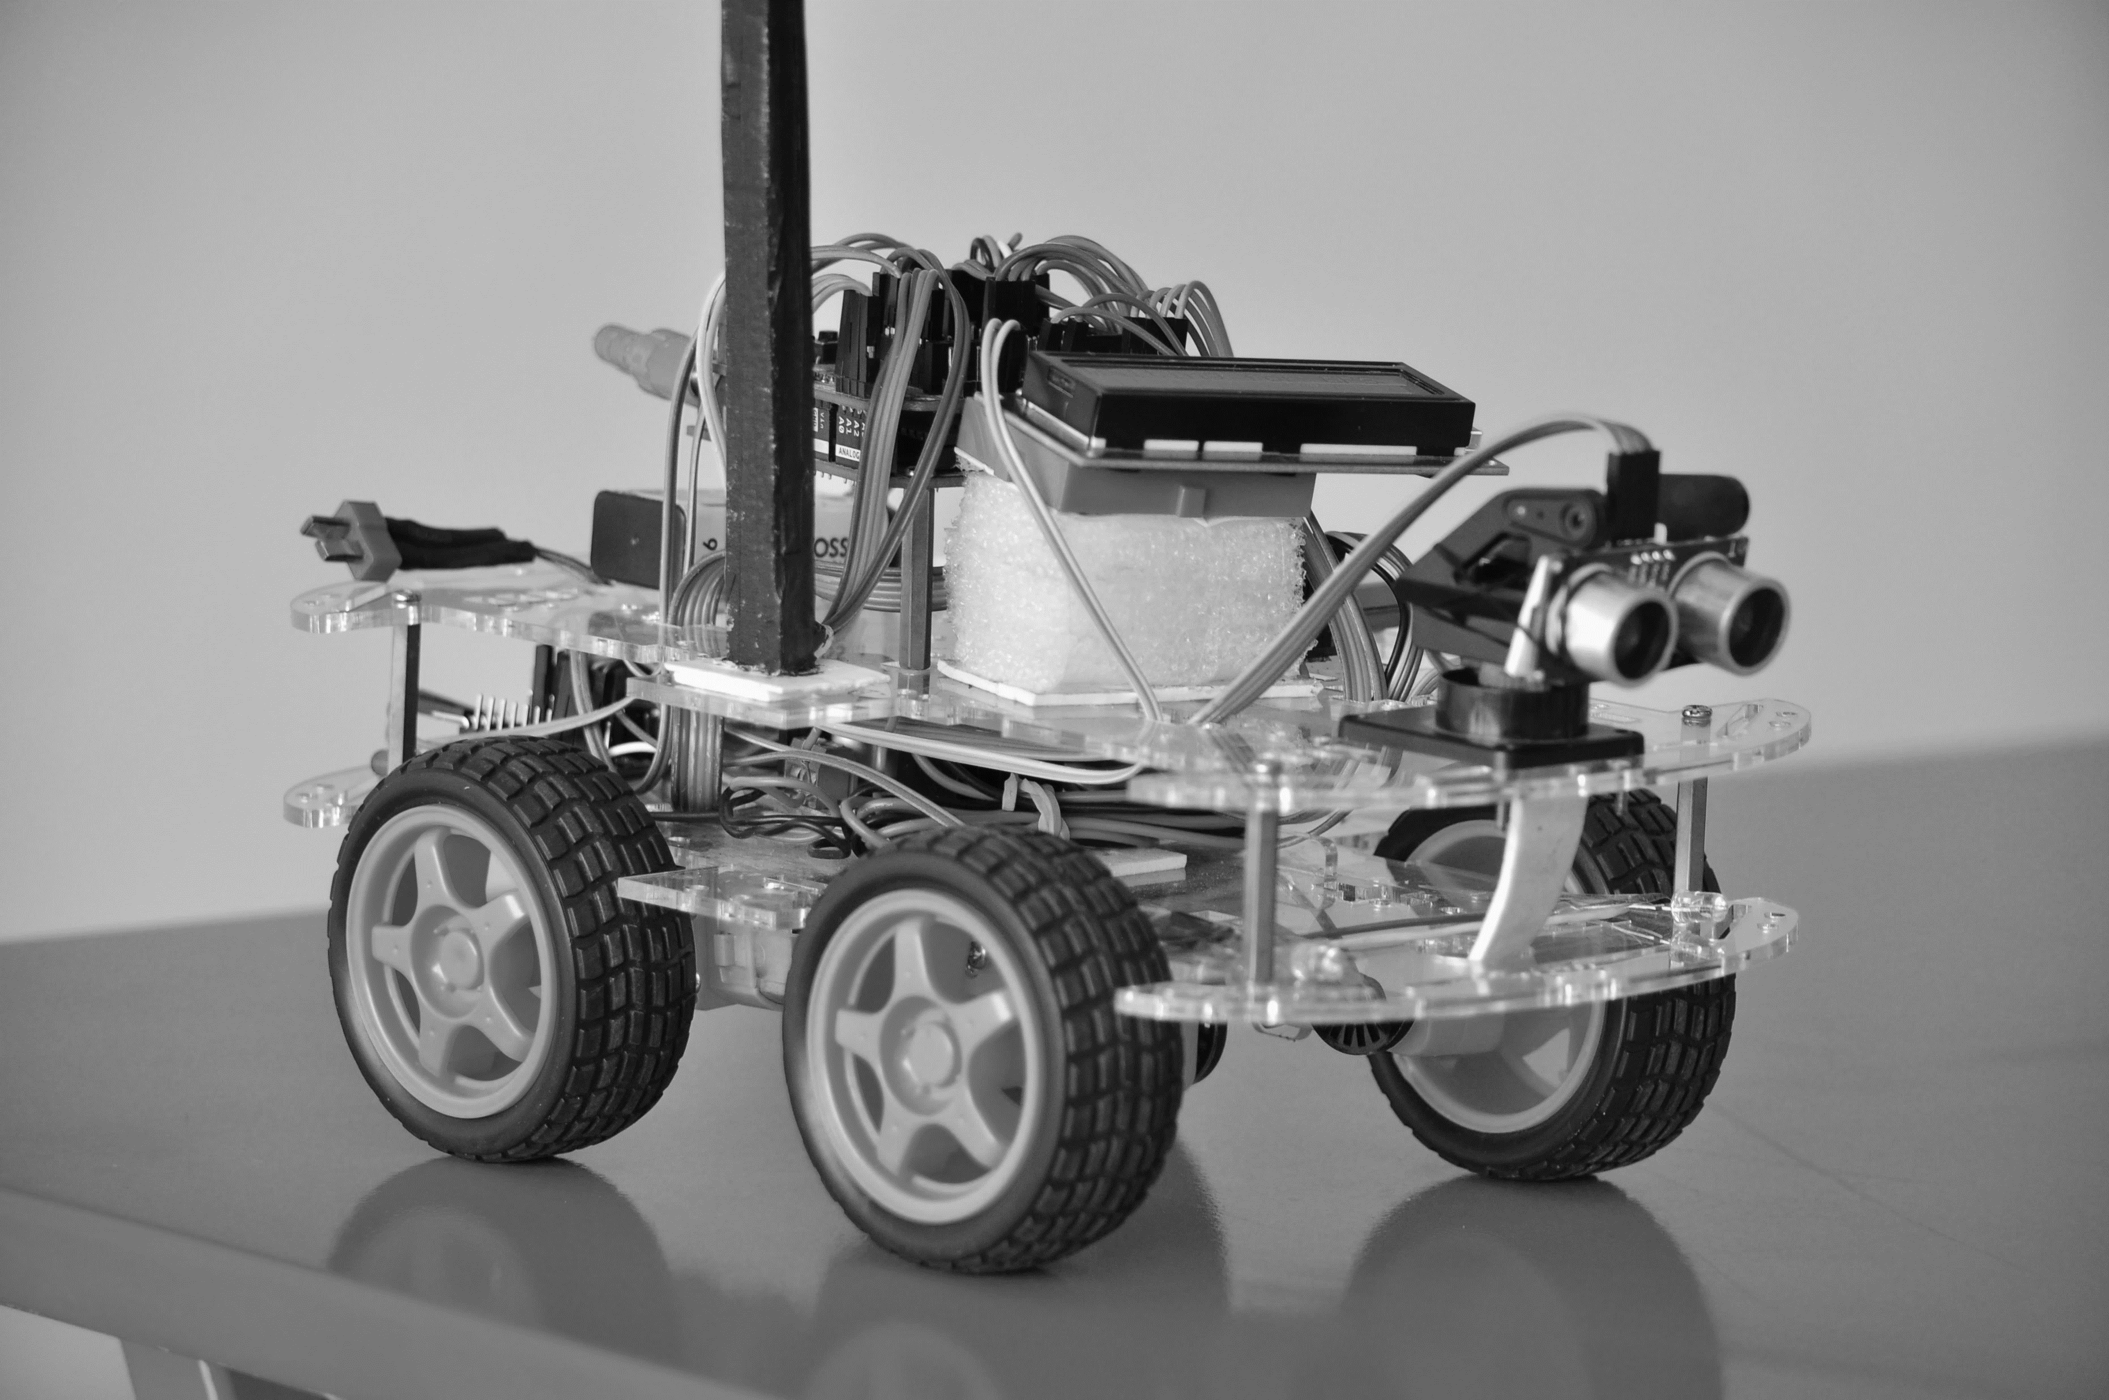


aucovei is ready for loading
Start loading. Dispatch in 30 minutes.
<
15 minutes
Snooze
Dismiss
Brian Wickham
Loading Supervisor
Gets notification on his mobile that aucovei has arrived. Loads the vehicle. Confirms the loading and dispatch of vehicle.

Slide 37
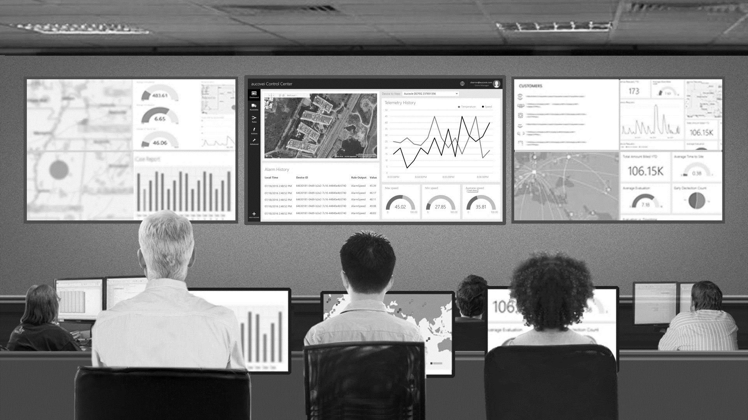
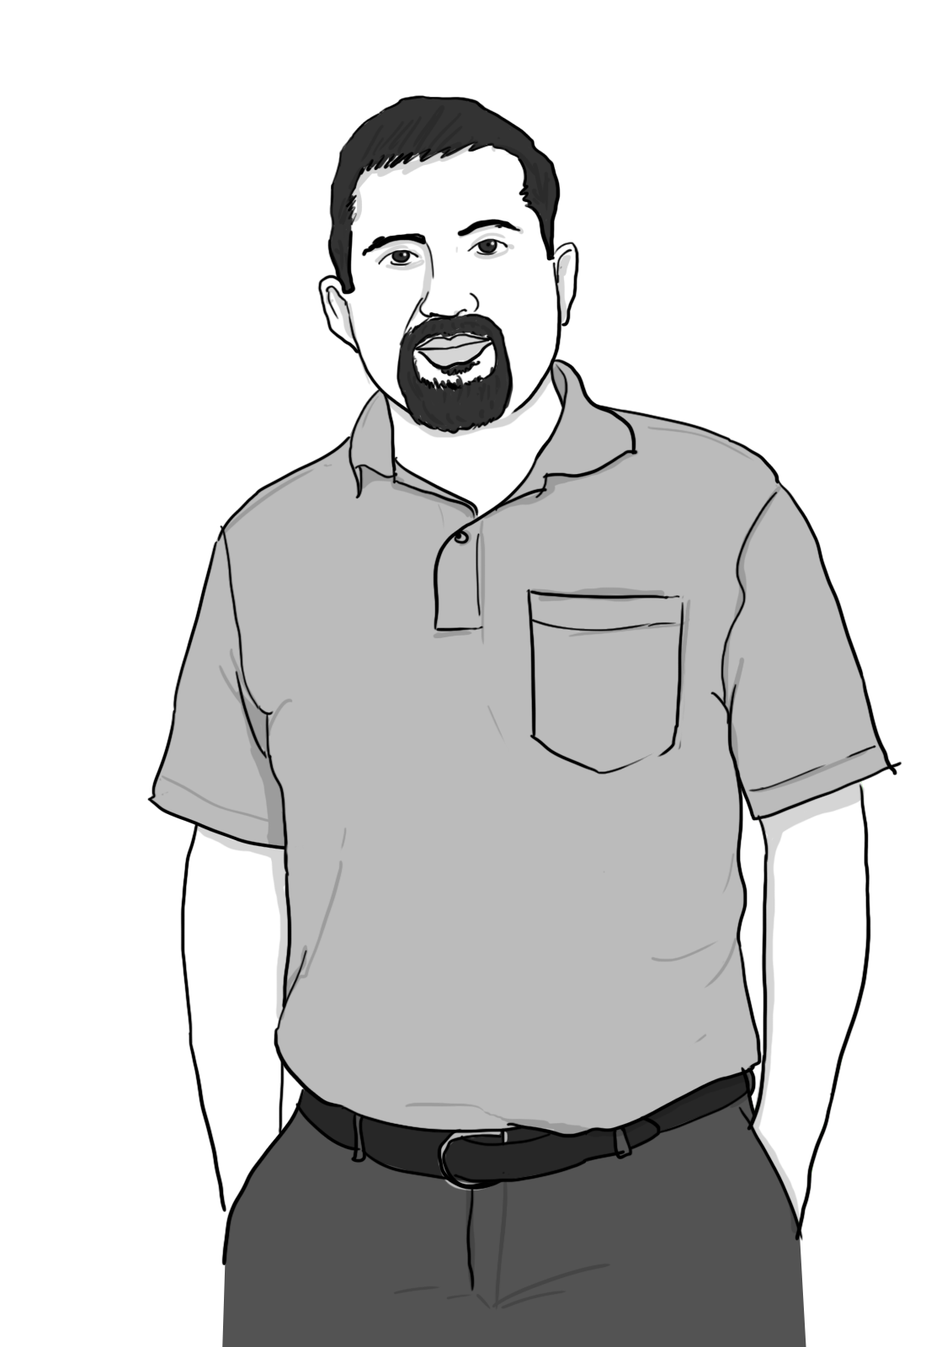
Robert Lyon
Control Room Operator
Track aucovei vehicle movement from the control room.
Take care of any issues if the aucovei gets stuck.

Slide 38
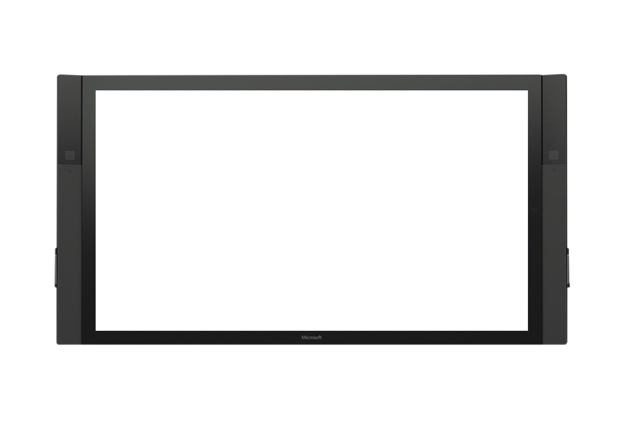

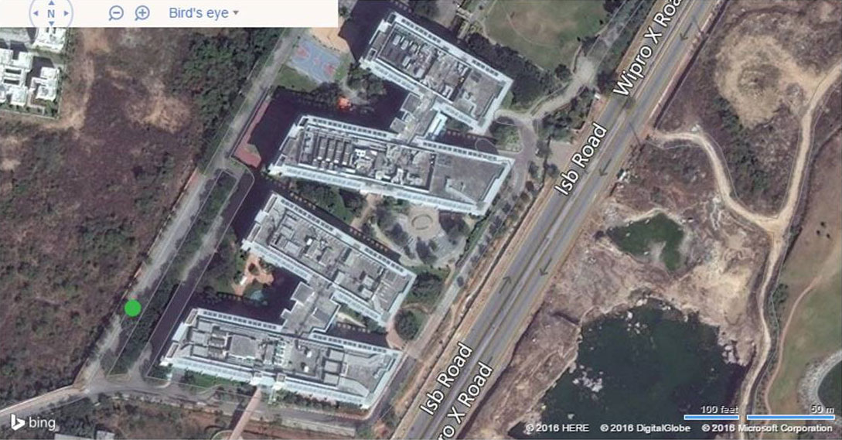



aucovei Control Center
robert@aucovei.com
ADMINISTRATOR
Device to View:
AUC 165
Dashboard
Aucoveies
Temperature
Speed
Rules
Actions
Advanced
Alarm History
Local Time | Device ID | Rule Output | Value
07/18/2016 2:48:52 PM | 64630181-04d9-b2e2-7c16-44840e4b5740 | AlarmSpeed | 45.39
07/18/2016 2:48:52 PM | 64630181-04d9-b2e2-7c16-44840e4b5740 | AlarmSpeed | 46.17
07/18/2016 2:48:52 PM | 64630181-04d9-b2e2-7c16-44840e4b5740 | AlarmSpeed | 48.11
07/18/2016 2:48:52 PM | 64630181-04d9-b2e2-7c16-44840e4b5740 | AlarmSpeed | 49.08
07/18/2016 2:48:52 PM | 64630181-04d9-b2e2-7c16-44840e4b5740 | AlarmSpeed | 48.83
45.02
27.85
35.81
0
100.00
0
100.00
0
100.00
ADD A AUCOVEI
Robert Lyon
Control Room Operator
Vehicle starts the journey. Notification goes to control room. Control room person can track the live vehicle movement (speed, direction (Bing Maps), etc.)

Slide 39
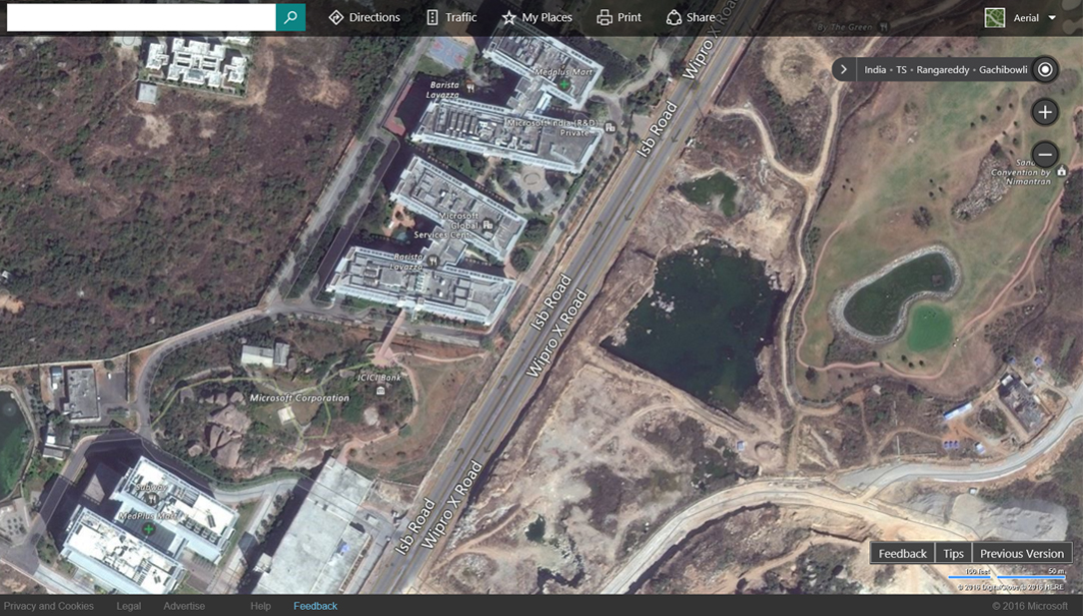
aucovei Control Center
robert@aucovei.com
ADMINISTRATOR
View
AUC 165 – Delivery 3452
A
Point A
Time remaining
Gate 2,
Contoso Campus
12 min
Point B
45.02
/21 min
Fabrikam Circle
35.81
B
Robert Lyon
Control Room Operator
Vehicle starts the journey. Notification goes to control room. Control room person can track the live vehicle movement (speed, direction (Bing Maps), etc.)

Slide 40


Case 1 - Clearing an obstacle without assistance
Finding an
alternate route
Reach the destination
using the alternate route
From Point A
Obstacle on the route
To Point B
aucovei
aucovei vehicle gets an obstacle (another truck that is unloading). Vehicle pauses, navigates to left, navigates to right; finds a gap and proceeds further.

Slide 41
Case 2 - Assistance from the Control Room
Send signal to
Control Room
Obstacle on the
alternate route
Difficulty in finding
an alternate route
From Point A
Obstacle on the route
To Point B
aucovei
aucovei vehicle gets another obstacle on the available alternate route. Vehicle is stuck now and sends a signal to the Control Room.

Slide 42

Case 2 - Assistance from the Control Room (contd..)
Detect roadblocked sign
on the route
Send signal to
Control Room
From Point A
Road block
To Point B
aucovei
aucovei vehicle detects a stop sign on the route. Vehicle is stuck now and sends a signal to the Control Room.

Slide 43
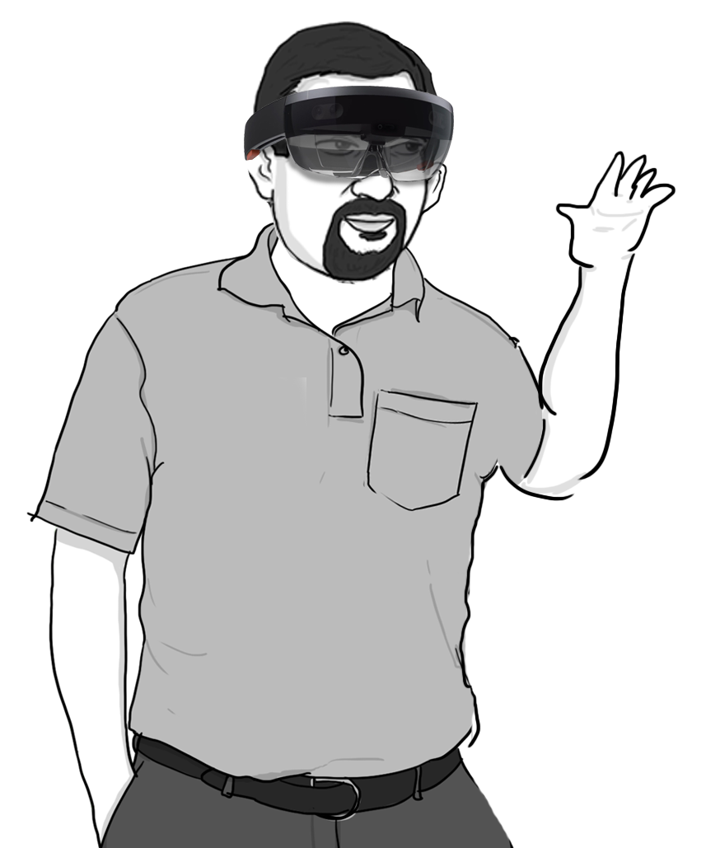
Case 2 - Assistance from the Control Room
aucovei Control Center
robert@aucovei.com
ADMINISTRATOR
View
AUC 165 – Delivery 3452
A
Point A
Time remaining
Gate 2,
Contoso Campus
12 min
Point B
45.02
/21 min
Fabrikam Circle
35.81
B
Robert Lyon
Control Room Operator
Operator in the Control Room receives a signal and using a Hololens device and the Camera in the aucovei he is helping find a nearest alternate route.
aucovei

Slide 44
Case 2 - Assistance from the Control Room
Take a U-return
Obstacle on the
alternate route
Go back to nearest alternate route
From Point A
Obstacle on the route
To Point B
Robert Lyon
Control Room Operator
Operator in the Control Room receives a signal and using a Hololens device and the Camera in the aucovei he is helping find a nearest alternate route.
aucovei

Slide 45
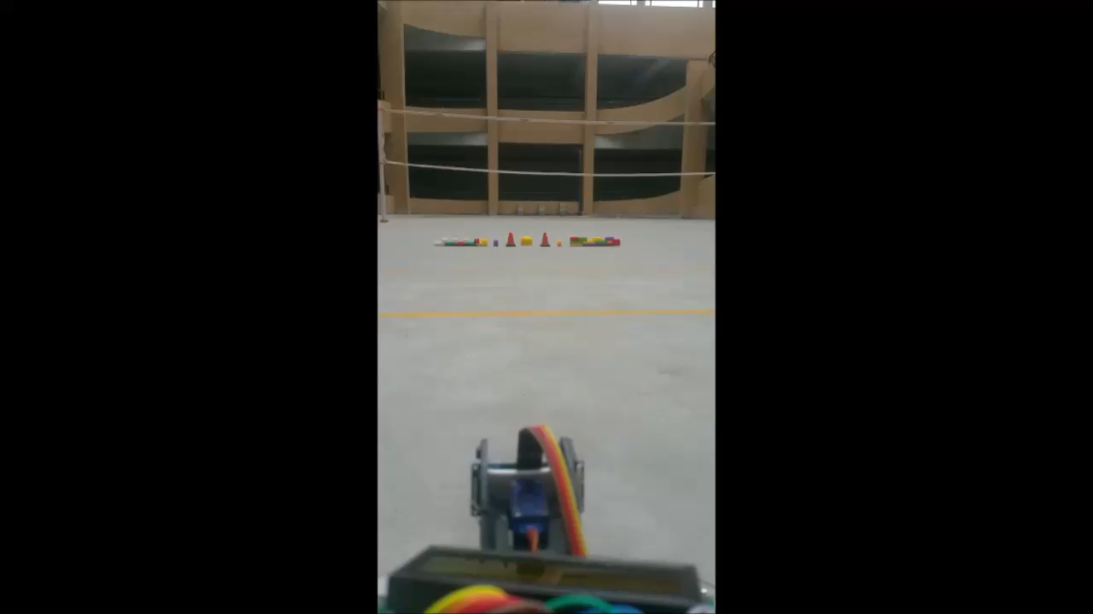
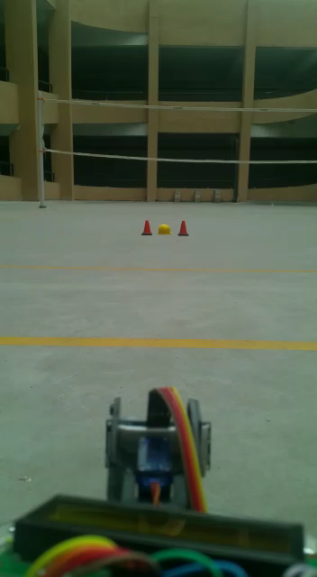
Clearing an obstacle without assistance
Needs assistance from the Control Room
aucovei
Real footage shot with the working aucovei vehicle to demonstrate the two scenarios.

Slide 46
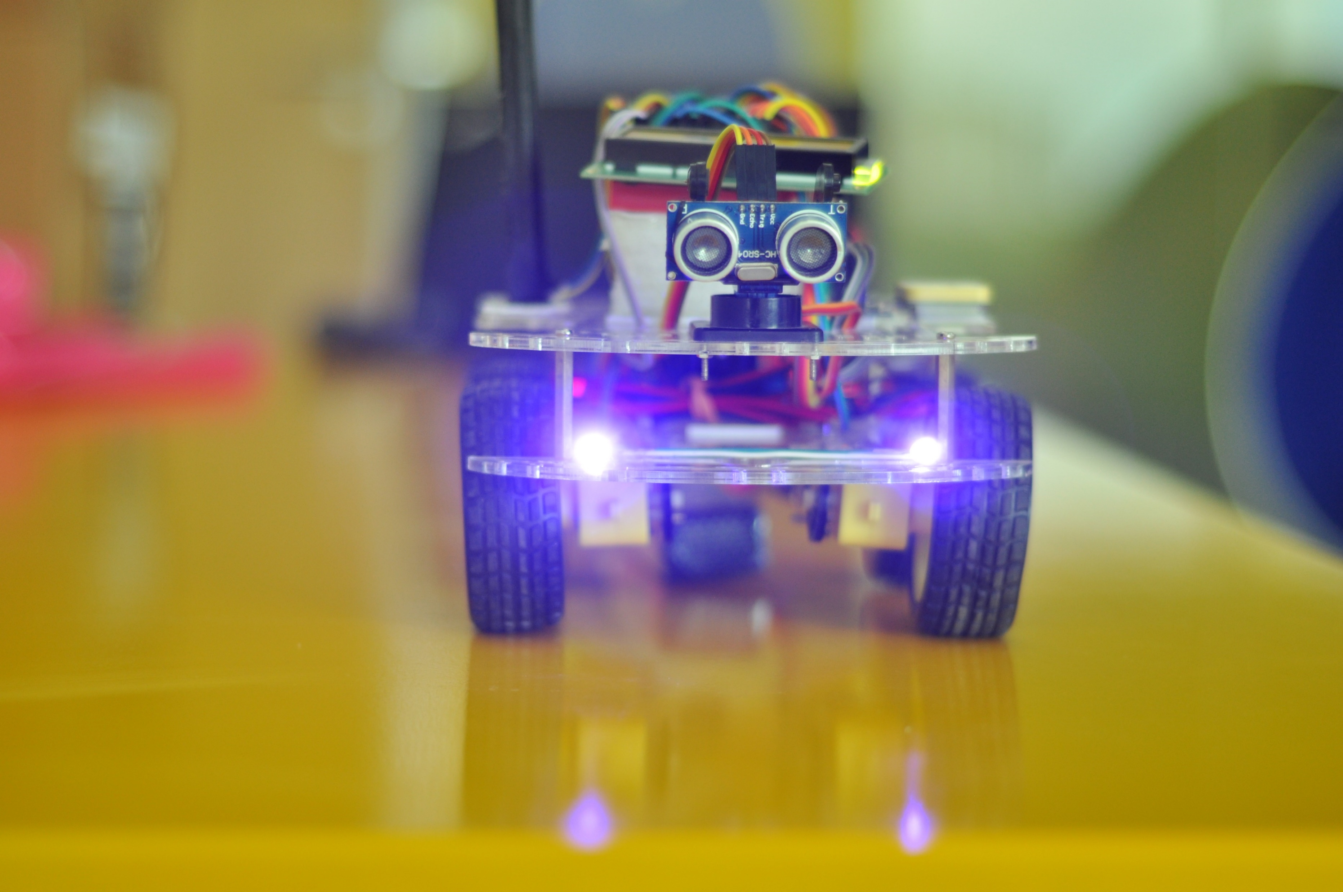
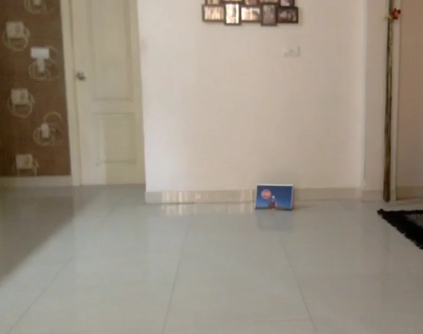
Sign Detection
aucovei
Real footage shot with the working aucovei vehicle to demonstrate the sign detection scenario.

Slide 47
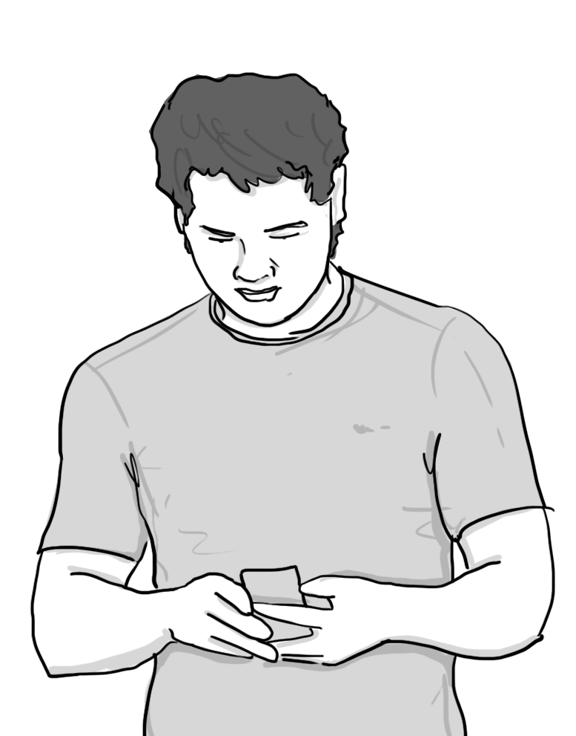

Johnathon Green
Loading-unloading supervisor at starting point B
Loading-unloading the aucovei vehicle as per the requirement received on the mobile
Dispatch the aucovei.
Johnathon Green
Loading Supervisor
The loading/unloading supervisor receives a message of the arrival of the aucovei, he goes and unloads the aucovie.
aucovei

Slide 48
After the successful delivery the aucovei vehicle parks itself to the nearest parking and awaits the next delivery assignment from the control room.

Slide 49

Solution Components
aucovei
Companion App
Control Center
Notes:
aucovei is an autonomous and connected car that is capable of sensing its environment and navigating based on the waypoints. Advanced control systems interpret sensory information based on navigation points, identify appropriate navigation paths, as well as obstacles.
Companion App is a mobile/tablet based app built to assist the field agents to operate aucovei.
aucovei Control Center is a fleet monitoring portal that allows monitoring real time alerts and telemetry and take appropriate actions.

Slide 50
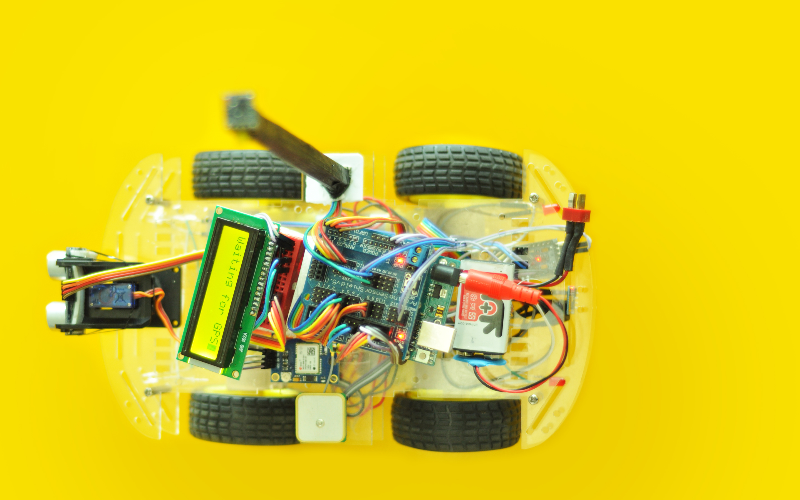
aucovei 1.0 Device Hardware
HMC5883L
Magnetometer
GPS Status LED
Motor
(Connected to L298-N Motor Driver)
GPS Status LED
Ultrasonic Sensor
Arduino Pro Mini
Servo
ESP8266
16x2 LCD Display
Power Connector
Ardunio Uno R3
Ardunio Uno Hat
U-blox Neo-6m
GPS

Slide 51
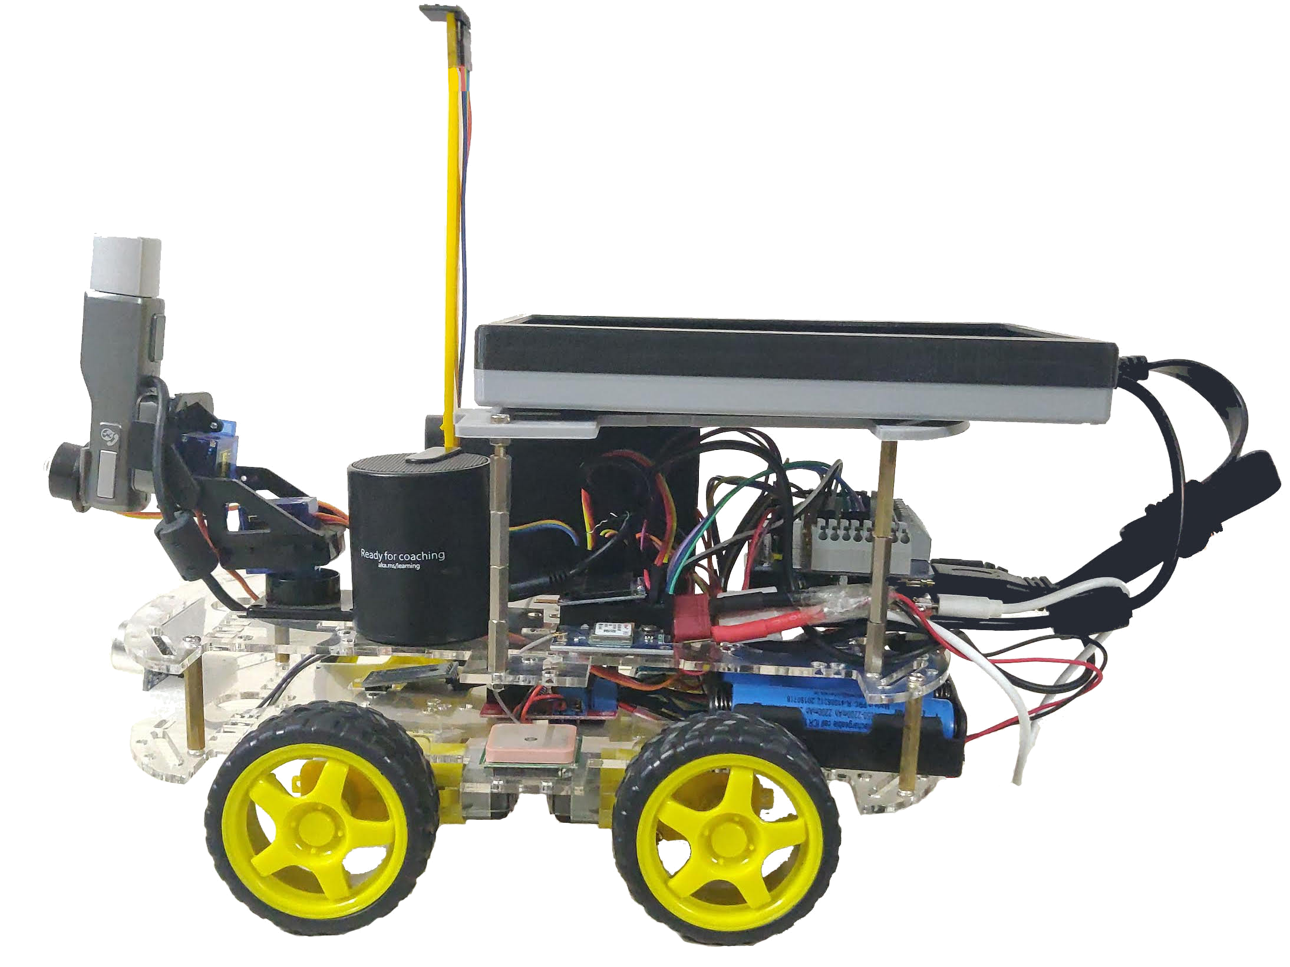
aucovei 2.0 Device Hardware
HMC5883L
Magnetometer
Microsoft Lifecam
LCD Touchscreen
Display
Powerbank
Speaker
Raspberry Pi 3 Model B+
LED
Servos
DHT 11 Temp
Sensor
Ultrasonic Sensor
OLED Display
Module (128x64)
Arduino Pro Mini
U-blox Neo-6m
GPS
LM393 Speed
Sensor
18650 Li-ion batteries
Motor
(Connected to L298-N Motor Driver)

Slide 52
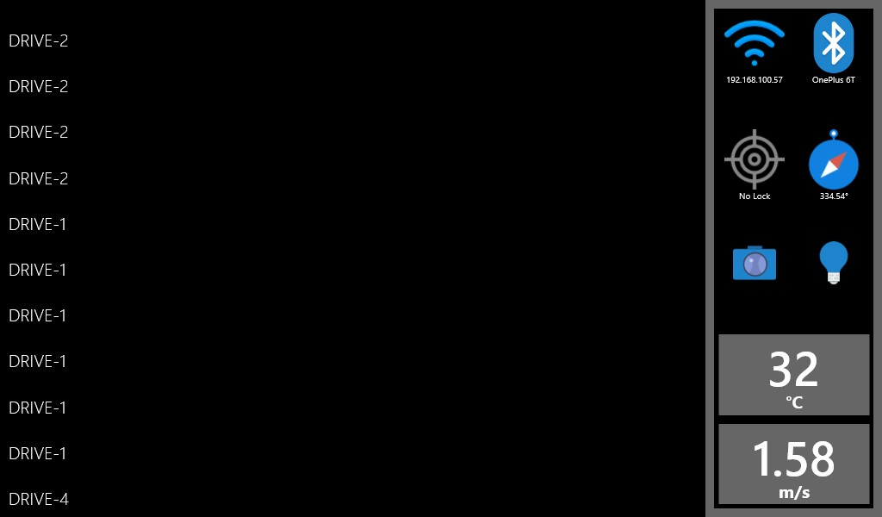
Device Display

Slide 53
Device Software
Raspberry Pi running Windows 10 IoT Core
Universal Windows Platform (UWP) app based on .Net Framework
OpenCV + Custom Vision Machine Learning Model (ONNX)
Live video streaming over websockets
Bluetooth Rfcomm
Voice Commands and Speech Synthesis
Azure IoT Hub communication
Arduino slave over I2C channel
Various sensor libraries

Slide 54




autonomous Mode
Waypoint Navigator
Waypoints Parser
Calculate Target Heading
d > thres.
No
Get Current Position
Calculate Distance
d = Current - Target
Cloud
Cloud Command Receiver
Turn Rover
Yes
Get Current Heading
Load Next Waypoint
Move Rover

Slide 55
Sign Detection
Raspberry Pi
Video Processor
Camera Processor
OpenCV
Windows ML Model
Command Processor
Video Camera
Capture video stream
Extract image frames
Detect contours based on size and color
Return largest contour
Evaluate cropped image against trained ML model
Process the results
Execute rover commands
Notify cloud

Slide 56
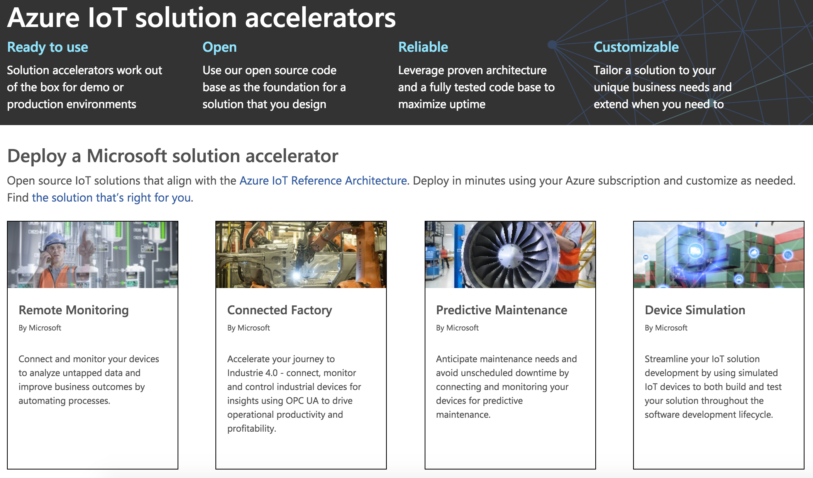
Azure IoT Solution Accelerators

Slide 57
Azure Remote Monitoring V1
Monitor IoT devices
Manage and configure devices
Send commands to devices
Configure device alerts
Detect device issues
Take actions based on issue type
Create simulated devices
Notes:
The Remote Monitoring solution accelerator implements an end-to-end monitoring solution for multiple machines in remote locations. The solution combines key Azure services to provide a generic implementation of the business scenario. You can use the solution as a starting point for your own implementation and customize it to meet your own specific business requirements.

Slide 58
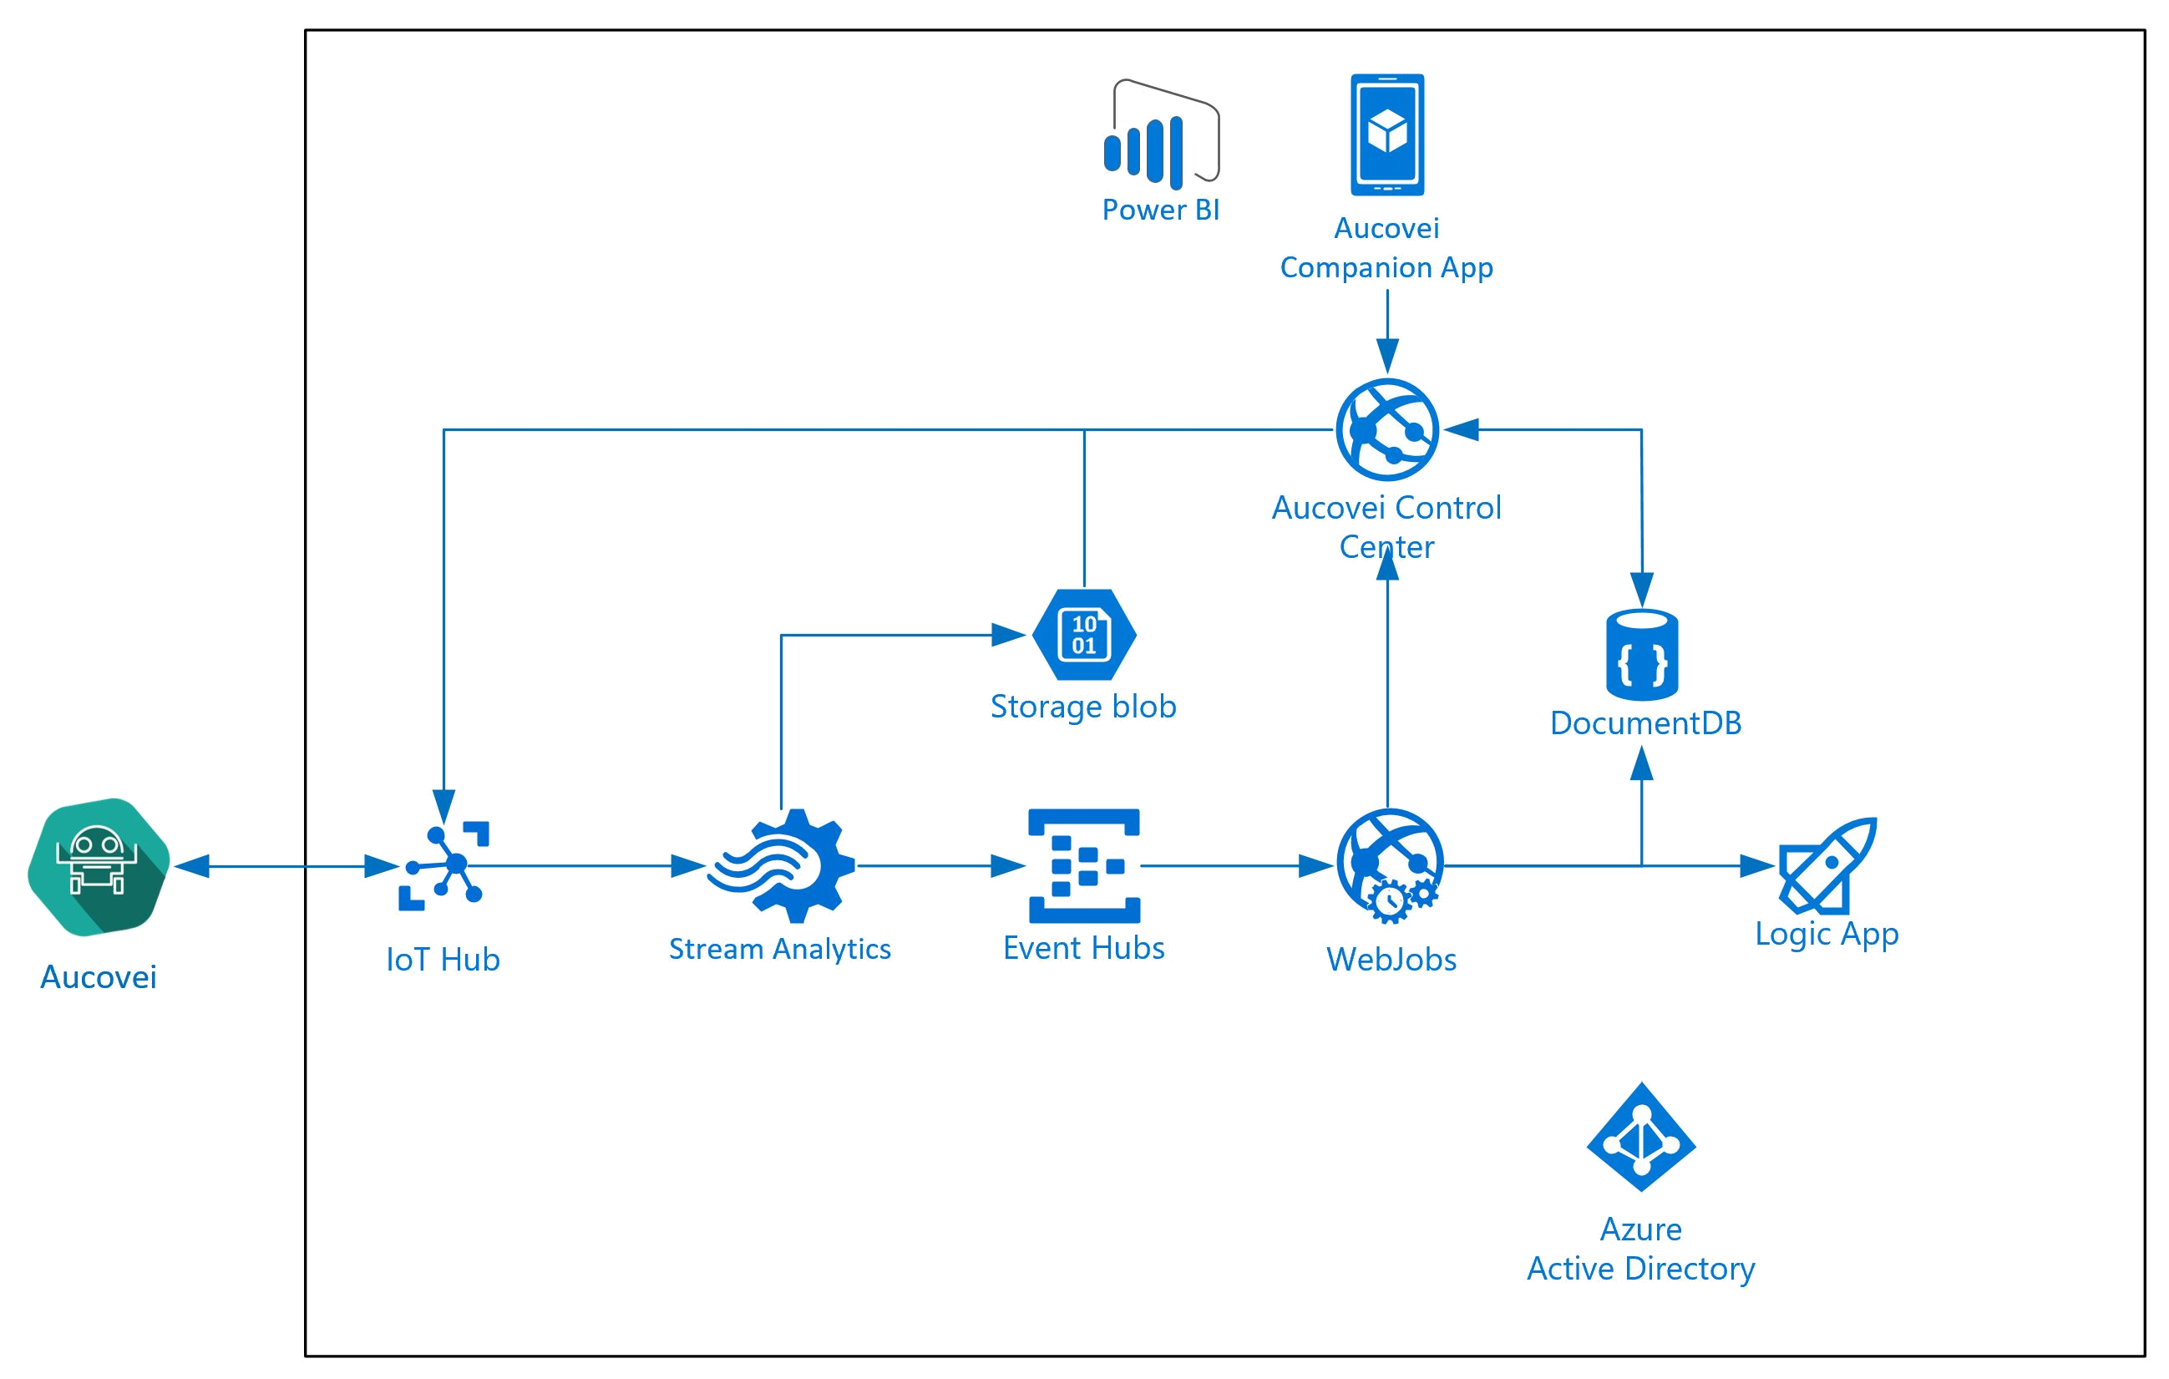
Cloud Architecture
Notes:
The Remote Monitoring solution accelerator implements an end-to-end monitoring solution for multiple machines in remote locations. The solution combines key Azure services to provide a generic implementation of the business scenario. You can use the solution as a starting point for your own implementation and customize it to meet your own specific business requirements.

Slide 59
References
Windows 10 IoT Core
Azure Custom Vision
Azure Remote Monitoring Preconfigured Solution
Windows Machine Learning Models
Windows Universal Application Samples
Windows IoT Core Samples

Slide 60

Thank You
Vivek Soni
LinkedIn: https://www.linkedin.com/in/vivek-soni-53014121/

